Slide 1




ISEEQ: Information Seeking question generation using Dynamic Meta-Information Retrieval and Knowledge Graphs
Manas Gaur^{ቸ} , Kalpa Gunaratna§, Vijay Srinivasan§, Hongxia Jin§
^{ቸ}Artificial Intelligence Institute, University of South Carolina, Columbia, USA
§Samsung Research America, Mountain View, California, USA
Notes:
ISEEQ is a curious conversational information-seeking dialog agent developed to assist end-user in getting the most appropriate and adequate information with minimal turns. This would support user engagement. Also, ISEEQ is designed from the perspective of a data creation agent to train new conversational information seeking.

Slide 2
People Spend Good Amount of Time Seeking Information on THE Web…
Seeking Information about
A Destination for making Travel Plan
Process to cook a delicious cuisine
A Health Condition with Insufficient Information
And Many More…
Human Information Seeking behavior:
Involves Common-sense
Follow a Conceptual Flow to improve search
Maintain Semantic Relevance between questions while maintaining conceptual flow
What if Human information Seeking Behavior Can be learnt by a dialog agent to Support User Engagement and Shape a cohesive Response
ISEEQ Does it!!
Notes:
After Human Seeking Behavior

Slide 3


Example 1 : Mental Healthcare
Traditional Dialog Agent
Query: Need Advice! I am bothered by feeling down or depressed
Query
Ask: What is bothering you?
Ask: Why are you feeling depressed about it?
Response
ISEEQ Agent
Query: Need Advice! I am bothered by feeling down or depressed
Query
Ask: Information Seeking Questions
1. Do you think you feel down most of the time?
2. How often do you feel depressed or hopeless?
3. How long have you struggled with depression?
Notes:
Takeaway points ( 2 points)

Slide 4
Example 2: Learn about Blockchain
Query: Need to learn about blockchain, relationship to cryptocurrencies and their importance
Query
Ask: Do you want to know about Blockchain?
Yes
Ask: Do you want to know about cryptocurrencies?
Yes
Ask: Do you want to know blockchain in currencies?
No
Lack of external knowledge can affect the shape of the generated question. For instance, in the context of blockchain, currencies is irrelevant.
As traditional dialog agent do not have access of meta-information and/or knowledge graph (KG)
Thus the generated questions are redundant and lack diversity,
Notes:
After Human Seeking Behavior

Slide 5
Example 2: Learn about Blockchain
Query: Need to learn about blockchain, relationship to cryptocurrencies and their importance
Query
1. Do you want to know about cryptocurrencies?
2. Do you want to know relation between blockchain and cryptocurrencies?
3. Do you want to know about bitcoin in blockchain?
Yes
Blockchain
Response
ISEEQ generates
Cryptocurrencies
Questions around entities in context and semantically related entities through commonsense KG
Specific to generic questions whose compiled response is cohesive.
Ethereum
Bitcoin
invented
facts
A simplified common-sense graph
Notes:
After Human Seeking Behavior

Slide 6
Conversational Information Seeking (CIS)
What is Conversational Information Seeking?
Conversational Information Seeking (CIS) is an emerging research area within Conversation AI that attempts to seek information from end-users in order to understand and satisfy user’s needs.
A CIS system can assist clinicians in pre-screening or triaging patients in healthcare.
Here, the agent is the propeller of a conversation with a user
What are Information Seeking Questions (ISQs) ?
ISQs differ from other question type (e.g Clarifying questions [1, 2], Follow-up questions [3]) by having a
Structure : semantic relations between questions and logical coherence
Cover Objective Details
Expand on the breath of topic
[1] Rao, S., and Daum ́e III, H. Learning to ask good questions: Ranking clarification questions using neural expected value of perfect information. In ACL 2018
[2] Zamani, H.; Dumais, S.; Craswell, N.; Bennett, P.; and Lueck, G. Generating clarifying questions for information retrieval. In Proceedings of The Web Conference 2020
[3] Pothirattanachaikul, S.; Yamamoto, T.; Yamamoto, Y.; and Yoshikawa, M. Analyzing the effects of” people also ask” on search behaviors and beliefs. In ACM HT and Social Media, 2020.
Notes:
Next see What ISEEQ is capable of doing

Slide 7
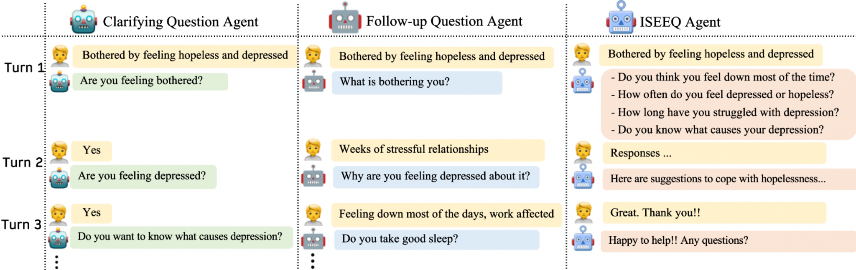
Advancing Current State in Conversational Information Seeking
ISEEQ generates context-specific questions that drill down from high-level questions to problem-focused questions faster than (Clarifying or follow-up )-based dialog agent.
ISEEQ reduce the number of turns to reach the desired information.
Notes:
Next see What ISEEQ is capable of doing

Slide 8


ISEEQ’s META-INFORMATIOn RETRIEVAL Can Enhance Current State in Conversational Information Seeking (CIS)
Current State
Tremendous amount of annotation effort
Searching the web [4]
Creating good quality questions [5]
Response Shaping [6]
Maintaining the information flow
Generated ISQs for training CIS Dialog Agent
QUERY
Passages
Lack Curiosity-driven Question Generation
Current CIS ask
Either Clarifying Questions
OR Follow-up Questions
Current process for creating dataset to train CIS agent
Generated ISQs for training CIS Dialog Agent
ISEEQ
QUERY
[4] Michael, J. et al. “Crowdsourcing question-answer meaning representations. In Proc. NAACL. 2018
[5] Rodriguez, P., et al. “Information seeking in the spirit of learning: A dataset for conversational curiosity.” In Proc. of EMNLP 2020.
[6] Saeidi, Marzieh, et al. "Interpretation of Natural Language Rules in Conversational Machine Reading." In EMNLP 2018.
Passages
ISEEQ for creating dataset to train a CIS agent
Notes:
This is for the related work

Slide 9
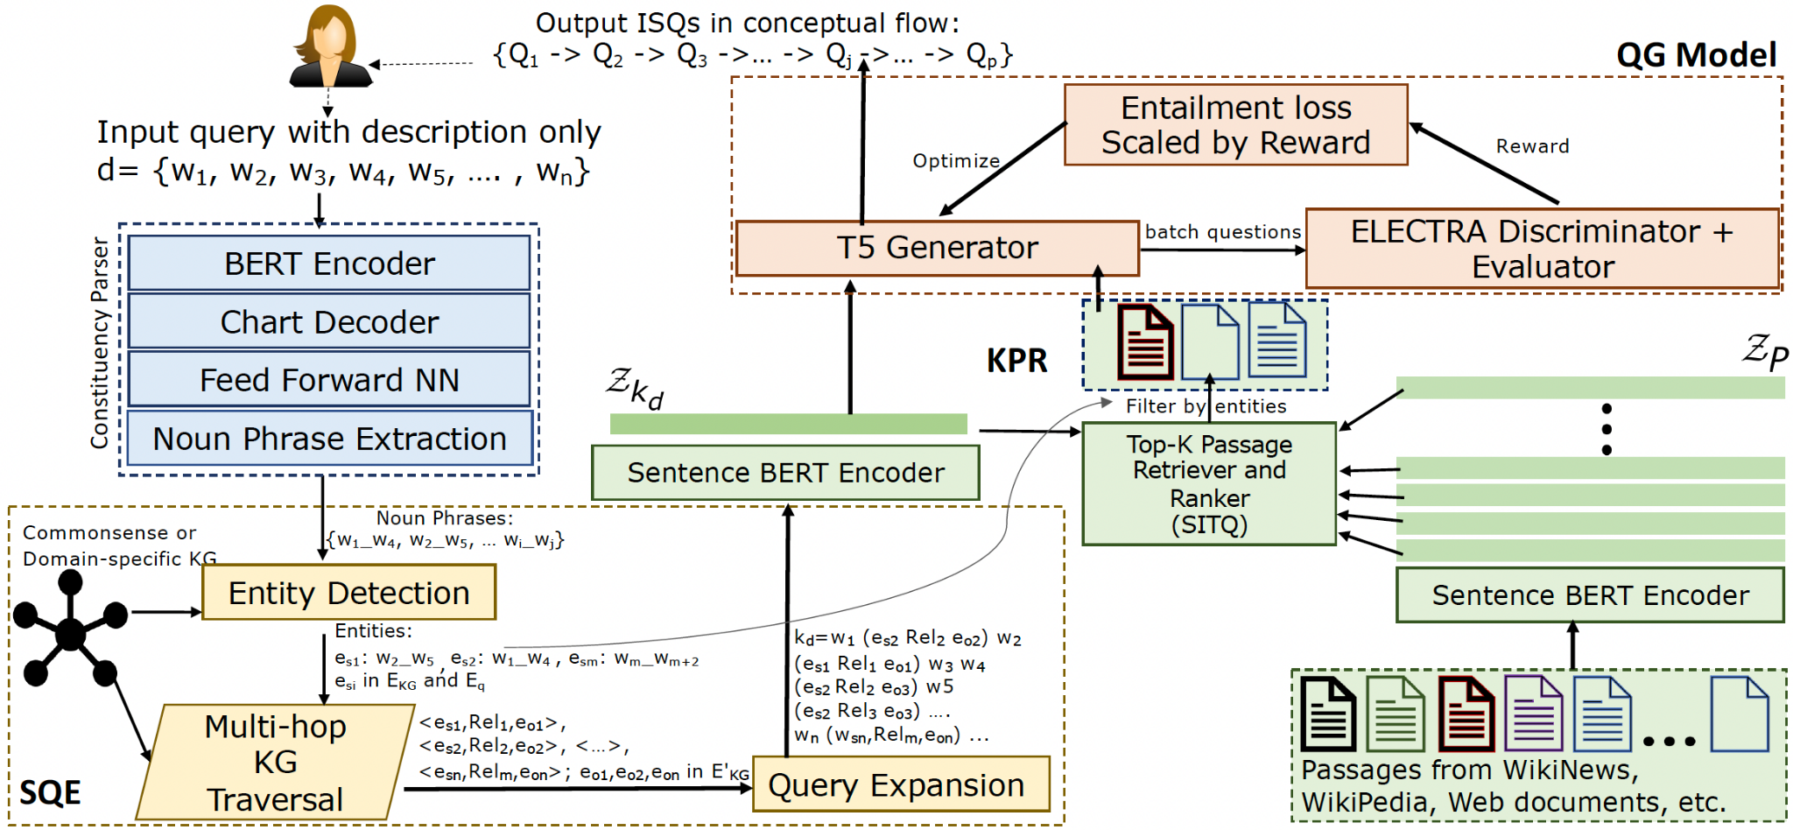




Finer Architecture of ISEEQ
ISEEQ Was Experimented On QuERIES FROM
Notes:
For the purpose of the ease of understanding and usage, we developed ISEEQ in a modular
Picture credits
https://www.freepik.com/premium-vector/mental-health-concept-man-meditating-with-health-icons_9644719.htm
(2) https://leverageedu.com/blog/political-leaders/

Slide 10



MODULAR Architecture of ISEEQ
ISEEQ Was Experimented On QuERIES FROM
Information Seeking Questions
Reinforcement Learning-based Question Generator
Query
Meta-Information Retrieval
Deep Constituency Parser
Knowledge-aware Passage Retriever and Ranker (KPR)
Sentence BERT Encoder
Sentence BERT Encoder
Semantic Query Expander
Commonsense knowledge graph
Passages
Entity Detection
Web Documents
Wikipedia
Notes:
Lets take example of Policy and Politics

Slide 11
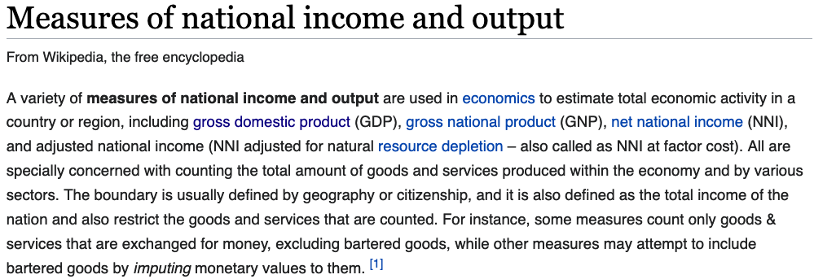

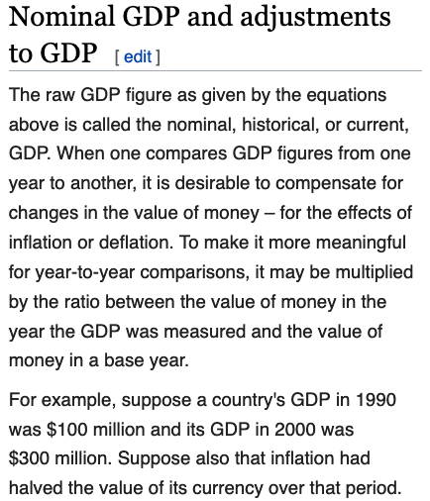
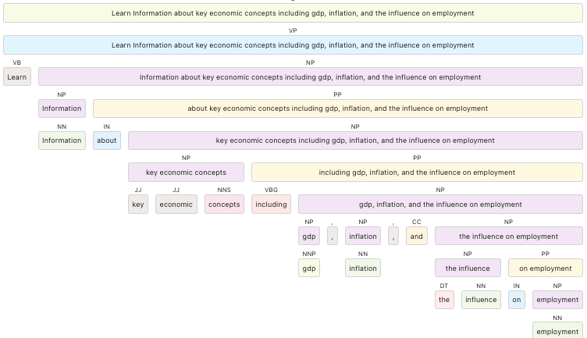
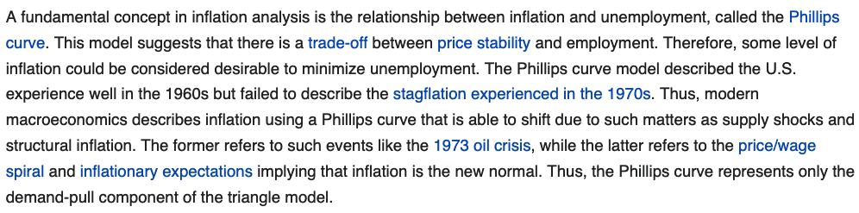
Illustration of ISEEQ
ISQ by Generative Adversarial Reinforcement Learning
Query
1. What is gross_domestic_product?
2. What is the measure of gross_domestic product?
3. What is the reason nation income relations gross_domestic_product?
4. What is the influence of inflation to gross_domestic_product?
5. What is the meaning of unemployment in inflation?
6. What is the influence of inflation on cost_of_living?
Title: Economy and Employment Statistics
Description: Learn Information about key economic concepts including gdp, inflation, and the influence on employment
Sentence BERT Encoder
Sentence BERT Encoder
Constituency Parsing
KPR
economics
Information + { economy, employment statistics, employment, influence employment, inflation influence employment, gdp, gdp influence employment, key economic concepts}
economy
inflation
employment
gdp
cost of living
unemployment
gross domestic product
gnp
income
gross national product
national income
personal income
income tax
ConceptNet Graph for Semantic Query Expansion
Notes:
For the purpose of the ease of understanding and usage, we developed ISEEQ in a modular
Picture credits
https://www.freepik.com/premium-vector/mental-health-concept-man-meditating-with-health-icons_9644719.htm
(2) https://leverageedu.com/blog/political-leaders/

Slide 12

About ISEEQ and its Variants ( , )
ISEEQ model with a generative adversarial reinforcement learning-based question generator (ISEEQ-RL). The reward function gives priority to questions:
That have entities which are >80% similar to entities in user query.
However, top-K questions by nucleus sampling always contains questions generated by longest common subsequence match [7].
ISEEQ-RL
ISEEQ model with a generative adversarial reinforcement learning-based question generator with Entailment constraints (ISEEQ-ERL).
Reverse Cross Entropy Loss (RCE):
Allows to place a thresholding strategy on adversarial generations
Entailed questions learn by simple cross-entropy loss (CE) -- Non-Adversary
Neutral and Contradictory questions were minimized by RCE -- Adversary
Using pre-trained RoBERTa to define entailment constraints, questions generated from ConceptNet triples appear in top-K.
Less redundant and more diverse question generation compared to
ISEEQ-ERL
[7] Holtzman, Ari, et al. "The Curious Case of Neural Text Degeneration." International Conference on Learning Representations. 2019.

Slide 13
Datasets to Evaluate ISEEQ (numbers are rounded to whole numbers)
QADiscourse (QAD) (Pyatkin et al. 2020)
Source for Passages: Wikipedia and WikiNews
Training Samples: 125 User Queries with 25 ISQs per Query (125 * 25 = 3,125 Query-Question Pair)
Testing Samples: 33 User Queries with 25 ISQs per Query
ConceptNet KG hit percentage: 38.5%
Question Answer Meaning Representation (QAMR) (Michael et al. 2018)
Source for Passages: WikiNews
Training Samples: 395 User Queries with 63 ISQs per Query
Testing Samples: 39 User Queries with 68 ISQs per Query
ConceptNet KG hit percentage: 35.5%
Facebook Curiosity (FBC) (Rodriguez et al. 2020)
Source for Passages: Geographic Wikipedia
Training Samples: 8489 User Queries with 6 ISQs per Query
Testing Samples: 2729 User Queries with 8 ISQs per Query
ConceptNet KG hit percentage: 50%
Conversational Assistance Track Dataset (CAsT-19) (Dalton et al. 2020) [ Dataset only to test ISEEQ, train and test merged)
Source for Passages: Microsoft MARCO (https://microsoft.github.io/msmarco/)
Training Samples: 30 User Queries with 9 ISQs per Query
Testing Samples: 50 User Queries with 10 ISQs per Query
ConceptNet KG hit percentage: 57%
Download Datasets:
https://github.com/manasgaur/AAAI-22
Notes:
Take 2 deductions from the paper

Slide 14
Evaluation Metrics for ISEEQ
In ISEEQ two components were evaluated (a) KPR and (2) Question Generator
KPR Evaluation Metrics:
Hit Rate on top 10 retrieved passages (HR@10)
Hit Rate on top 20 retrieved passages (HR@20)
Mean Average Precision over all diverse and varied length queries (MAP)
Question Generator Evaluation Metrics:
Rouge-L (R-L) : ISEEQ atleast generate questions on the entities in user query
BLEURT (BRT) : measure preservation of syntactic context, semantics, and legibility of generated question to human understanding. (Sellam, Das, and Parikh, 2020)
BERTScore (BScore) : ISEEQ also generate questions with entities related to entities in user query (Zhang et al. 2019)
Semantic Relations (SR*): SR in the generations is computed across all pairs using RoBERTa pretrained on semantic similarity tasks.
Logical Coherence (LC**): LC between Q^{p+1} and Q^{1:p} is computed from counting the labels predicted as “entailment” by RoBERTa pre-trained on SNLI dataset.
*https://huggingface.co/textattack/roberta-base-STS-B
** https://paperswithcode.com/lib/allennlp/roberta-snli
Notes:
Take 2 deductions from the paper

Slide 15
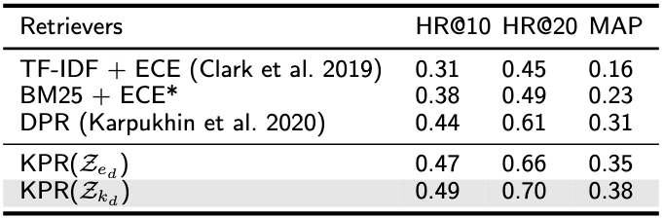
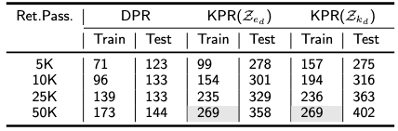
Quantitative Evaluation on ISEEQ (KPR)
Evaluating KPR. ECE: Electra Cross Encoder, (*): variant of Clark et al. 2019. DPR: Dense Passage Retrieval
Performance of KPR on MS-MARCO passages while retrieving atleast one passage per query in CAsT-19
In terms of Relevant Passages retrieved KPR (entities in ConceptNet KG (k_{d}) and Noun Phrases (e_{d})) outperformed Dense Passage Retrieval. (d: description)
[left] : Majority of the questions per query in QAMR were about the entities in the query. Thus, KPR outperformed baselines
[right]: 269 (30 Queries and 9 questions per query) is the size of the CAST-19 train set. KPR covered the train set but left 16 % of the queries in test set (479 is the size of test set).
For this evaluation, KPR retrieved and ranked the passages in batches of 5K, 10K, 25K, and 50K
KPR retrieved and ranked much less passages than other methods. This gave speed to ISEEQ
Notes:
Take 2 deductions from the paper

Slide 16
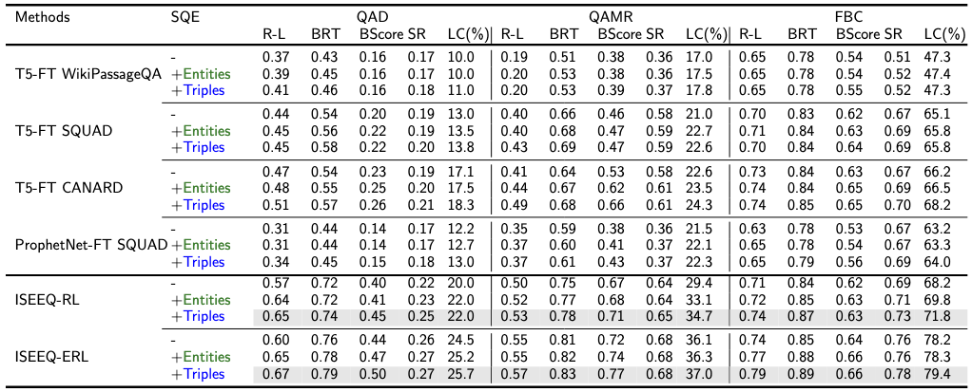
Quantitative Evaluation on ISEEQ (Question Generator)
Considered baselines were Transformer-based models trained on Question-Answering Datasets having external passage source.
For fair evaluations, ISEEQ model’s performance was recorded after KPR has a
stable list of retrieved passages.
3. Ablation study was performed as follows:
ISQ’s generated from retrieved passages alone
ISQ’s generated from passages and e_{d} .
ISQ’s generated from passages and concatenated entity set of (k_{d} + e_{d} )
Scores on the test sets of QAMR, QAD, and FBC
Notes:
Take 2 deductions from the paper

Slide 17
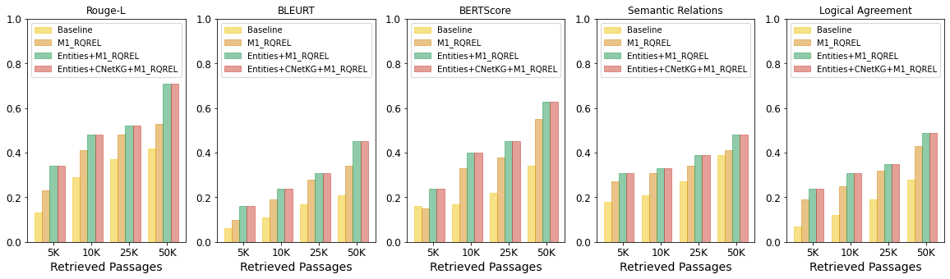
ISEEQ On CAST-19
Generated 27% more questions that are semantically similar to ground truth compared to baseline: T5 CANARD model.
Use of KG or contextual information in the form of entities sees a significant boost in the quality of generated questions with minimal set of retrieved passages.
Without entailment constraints, questions generated by KG triples never made to top-K. Hence performance of with or without KG triples is same.
Notes:
After Human Seeking Behavior

Slide 18
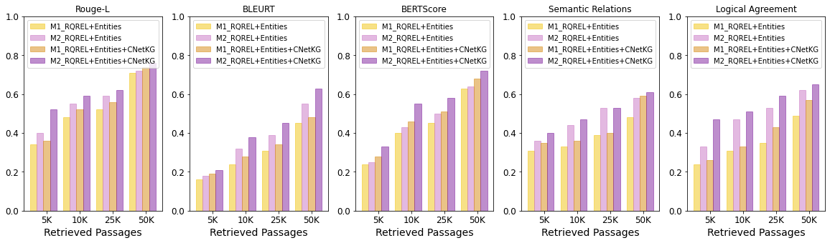
ISEEQ On CAST-19
Forcing the entailment constraints in yielded high scores on Semantic Relation and Logical Agreement -- Conceptual Flow.
This performance is seen uniformly from minimal set of 5K passages to 50K passages.
Though in initial epochs, “entity only” generated question takes precedence over questions generated using triples from KG.
In higher epochs, questions generated from passages retrieved from ConceptNet information took precedence. Longer training cycles for over ( ~2 hours long).
Notes:
After Human Seeking Behavior

Slide 19
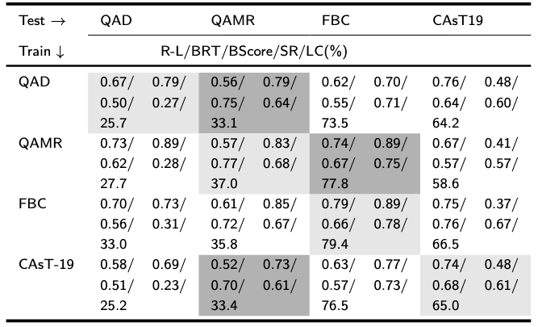
Transferability Test Using ISEEQ
Trained on a narrow domain dataset like QAMR, generated far better ISQs for queries in larger dataset : FBC
Transferability test was performed to show ability to create new datasets for training and development of CIS systems
Transferability Test using
Trained and tested on same dataset
Shows those cross-domain {Train-Test} pairs where ISEEQ shows acceptable performance. ISEEQ was trained on small size dataset and tested on relatively large dataset.
Notes:
Take 2 deductions from the paper

Slide 20
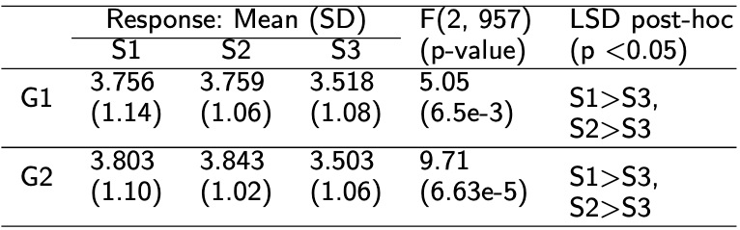
Human Evaluation on ISEEQ
30 queries were given to 12 annotators:
Mental Health: 7
Politics and Policy: 6
Geography: 5
General Health: 3
Legal News: 2
Others: 4
G1: ISQs are diverse in context and non-redundant
G2: ISQs are logically coherent and share semantic relations
Method: We measured statistical significance by first performing ANOVA and then using Least Significant Difference (LSD) post-hoc analysis
S1: Ground truth
S2:
S3: T5-CANARD (Baseline)
“>”: difference is statistically significant; S1 is statistically significant than S3
Notes:
Take 2 deductions from the paper

Slide 21
Summary
1. is the first CIS dialog agent in its class that infuses knowledge, entailment constraints, and self-guides itself to generate diverse, conceptually coherent and related questions.
2. The generative-adversarial training allows to strike a balance between the entities mentioned by users and entities from KG while generating questions.
3. opens up future research directions in CIS by facilitating the automatic creation of large-scale CIS datasets to develop and train improved CIS systems.
4. Crowd-workers can focus on evaluating and augmenting such datasets rather than creating them anew, thus improving dataset standards.
5. Broadly construed, through reinforcement learning with the reward on conceptual flow and logical agreement, can be trained to generate questions that are safety constrained and follow a specialized knowledge processing [8]
[8] Sheth, Amit, Manas Gaur, Kaushik Roy, and Keyur Faldu. "Knowledge-intensive language understanding for explainable ai." IEEE Internet Computing 25, no. 5 (2021): 19-24.
Notes:
Take 2 deductions from the paper

Slide 22
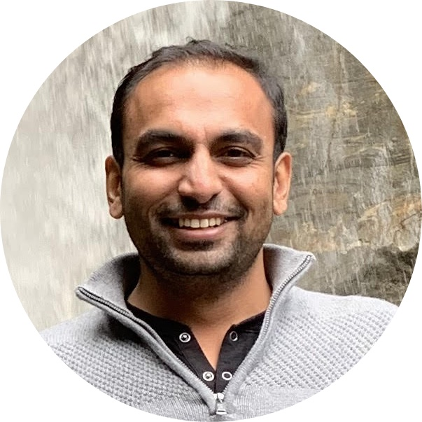



ISEEQ
Furthers the research in Conversational Assistance and Conversational Information Seeking
Manas Gaur
Kalpa Gunaratna
Vijay Srinivasan
Hongxia Jin
Check out our paper, datasets, and further details at
https://github.com/manasgaur/AAAI-22
Picture credits in this presentation:
https://leverageedu.com/blog/political-leaders/
https://www.freepik.com/premium-vector/mental-health-concept-man-meditating-with-health-icons_9644719.htm

